Slide 1
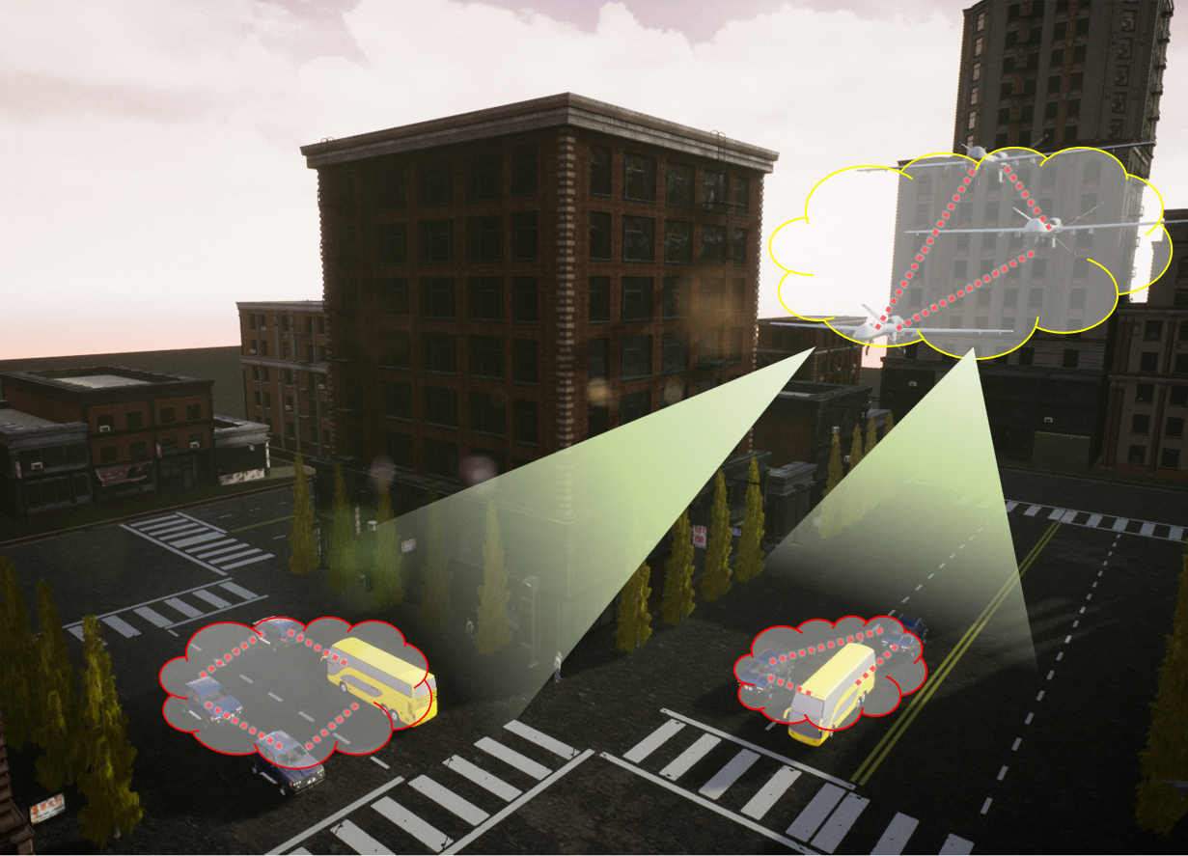
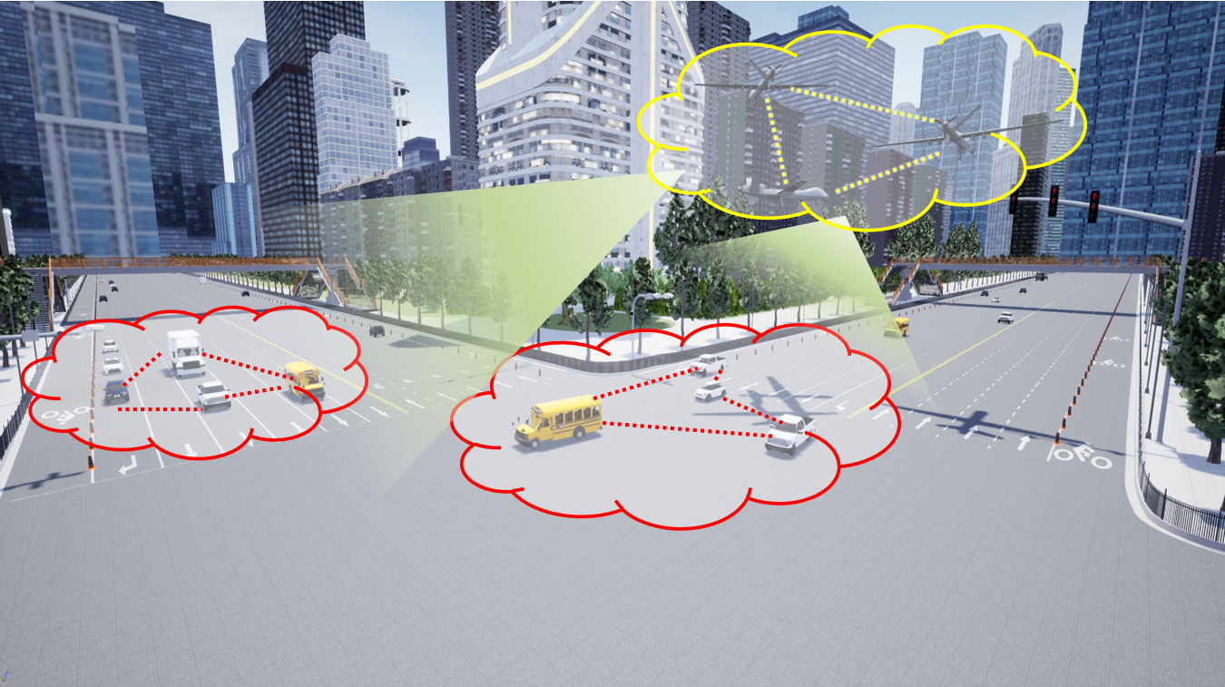
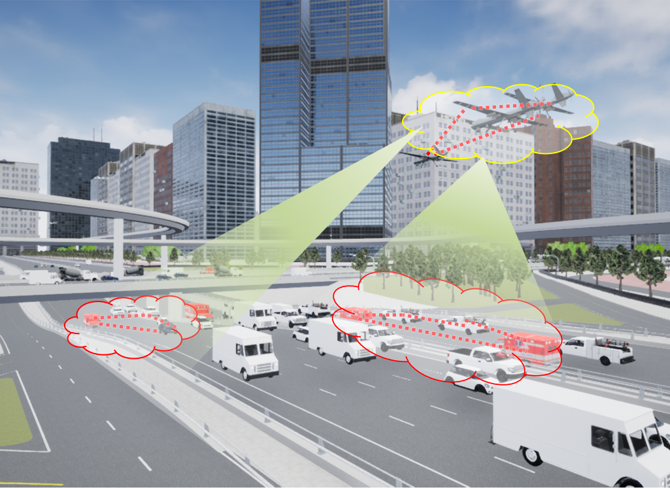
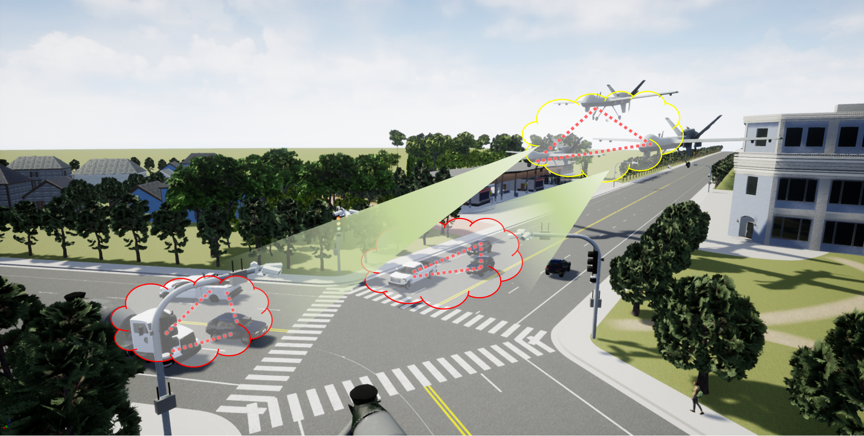
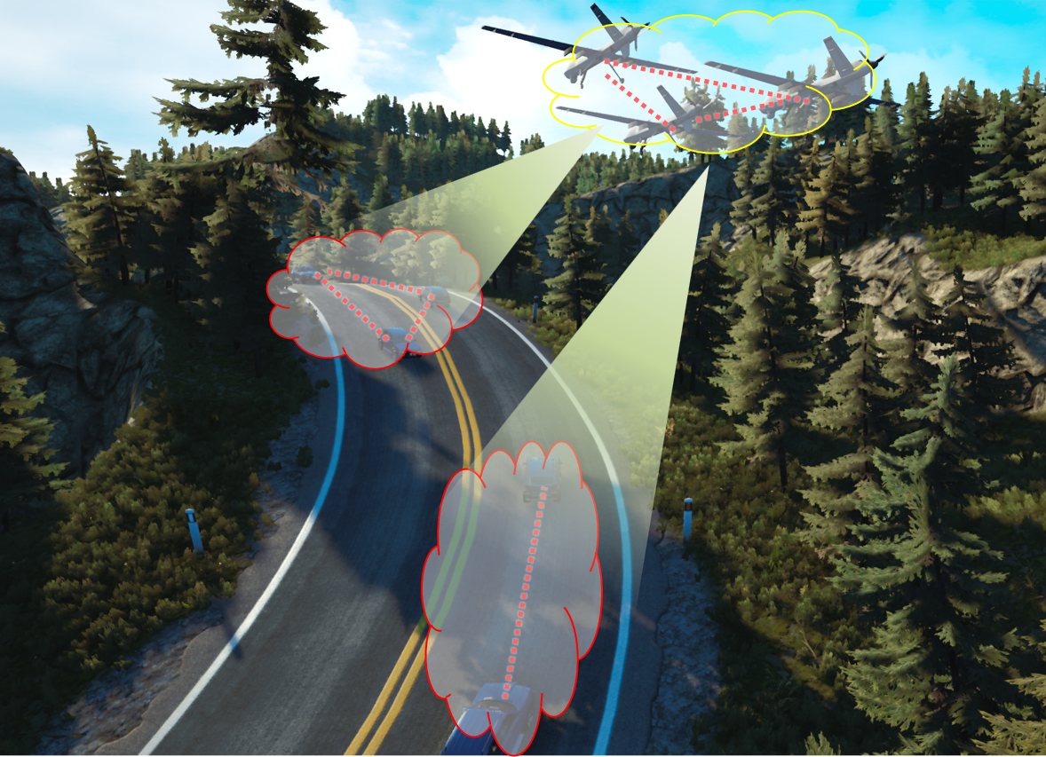
Air-ground multi-link cooperative urban crossroad scenario
Air-ground multi-link cooperative urban wide lane scenario
Air-ground multi-link cooperative urban overpass scenario
Air-ground multi-link cooperative suburban fork scenario
Air-ground multi-link cooperative mountain road scenario

